Slide 1
MODULE 4: Mathematical Logic:
Propositional and Predicate Logic,
Propositional Equivalences
Normal Forms,
Predicates and Quantifiers
Nested Quantifiers,
Rules of Inference

Slide 2
Mathematical Logic
The study of formal systems used to represent statements, determine their truth values, and establish whether arguments are logically valid.
Logic is important in computer science because it forms the foundation of:
  Programming and algorithms
  Database queries
  Artificial intelligence
  Digital circuit design
  Formal verification
  Automated reasoning
  Discrete mathematics

Slide 3
Basic Concepts
Proposition: a declarative statement that is either true or false, but not both.
Examples:
  "5 is greater than 3." → True
  "10 is an odd number." → False
  "Kochi is in Kerala." → True
The following are not propositions:
  "What is your name?" – Question
  "Close the door." – Command
  "x + 5 = 10" – Depends on the value of x

Slide 4
Propositional Logic
A proposition is a collection of declarative statements that has either a truth value "true” or a truth value "false".
A propositional consists of propositional variables and connectives.
We denote the propositional variables by capital letters (A, B, C etc).
The connectives connect the propositional variables.
Examples:
  "Man is Mortal", it returns truth value “TRUE” as T. •
  "12 + 9 = 3 − 2", it returns truth value “FALSE” as F.
Example not a Proposition
  "A is less than 2".

Slide 5
Logical Connectives
Propositions can be combined using logical connectives.
Connective | Symbol | Meaning
Negation | ¬P | NOT P
Conjunction | P ∧ Q | P AND Q
Disjunction | P ∨ Q | P OR Q
Exclusive OR | P ⊕ Q | P XOR Q
Implication | P → Q | IF P, THEN Q
Biconditional | P ↔ Q | P IF AND ONLY IF Q

Slide 6
Negation (¬)
− The negation of a proposition A (written as ¬A) is false when A is true and is true when A is false
P | ¬P
T | F
F | T
Example:
P: "Today is Monday.“
¬P: "Today is not Monday."
Truth Tables: A truth table shows all possible truth values of a proposition.
For n propositions, the number of combinations is:2^{n}

Slide 7
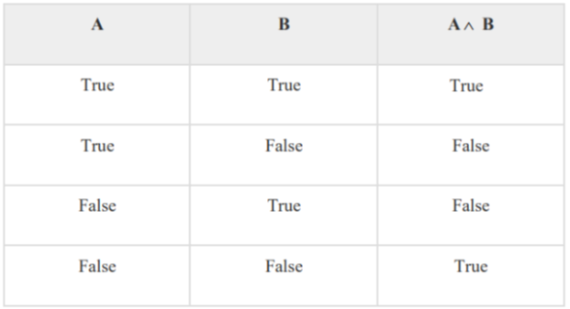
Conjunction – AND - ∧
The AND operation of two propositions A and B (written as A ^ B) is true if both the propositional variable A and B is true.
Example:
p: "I attend the class."
q: "I submit the assignment."
p∧q :"I attend the class and submit the assignment."

Slide 8
Disjunction – OR- V
The OR operation of two propositions A and B (written as A v B) is true if at least any of the propositional variable A or B is true.
Example:
  p: I will have tea.
  q: I will have coffee.
p∨q :I will have tea OR coffee.

Slide 9
Exclusive OR – XOR -⊕
The exclusive OR is true when exactly one of p and q is true.
  p⊕q
P | Q | P ⊕ Q
T | T | F
T | F | T
F | T | T
F | F | F
Example:
P: The student chooses Python.
Q: The student chooses Java.
Statement:
The student can choose either Python or Java, but not both.

Slide 10
Implication P->Q
The implication:P->Q is read as: "If p, then q.“
  It is false only when p is true and q is false.
P | Q | P → Q | ¬P∨Q
T | T | T
T | F | F
F | T | T
F | F | T
Example:
P: "A student studies.“
Q: "The student passes.“
P->Q "If a student studies, then the student passes."
Equivalence:
p→q≡¬p∨q

Slide 11
Biconditional - ↔
The biconditional is:P ↔ Q means: "p if and only if q.“
It is true when p and q have the same truth value.
Equivalence: P↔Q≡(P→Q)∧(Q→P)
P | Q | P ↔ Q | P→Q | Q→P | (P→Q)∧(Q→P)
T | T | T
T | F | F
F | T | F
F | F | T

Slide 12
Well Formed Formulas(WFF)
The well formed formulas(WFFs) or statement formulas or logic formulas are defined recursively (or inductively) as below.
Propositional variables P,Q,R,… and propositional constants F,T are well formed formulas. They are known as primitive WFFs.
If P and Q are WFFs then ¬Q, ¬P and Q ∧ P, QVP, P->Q, P<->Q are also WFFs.
All WFFs are obtained by the above procedures applied a finite number of times.
For example, the following are WFFs
  p ∧ (q → r) = (p ∧ q)→r
  (p → q)→(q → p)

Slide 13
EXERCISE
Construct the truth table for the formula PV~Q
Construct the truth table for the formula (PVQ)V~P

Slide 14
EXERCISE
Using the statements
  R: Mark is Rich
  H: Mark is Happy
  Write the following statements in symbolic form:
  Mark is poor but happy
  Mark is rich or Unhappy
  Mark is neither rich nor happy
  Mark is poor or he is both rich and unhappy

Slide 15
Tautology, Contradiction and Contingency
A tautology is a formula which is always true for every value of its propositional variables. Eg: p∨¬p
Prove [(A → B) ∧ A] → B is a tautology

Slide 16
Tautology, Contradiction and Contingency
A contradiction is a formula which is always false for every value of its propositional variables. Eg: p ∧ ¬p
Prove (A VB) ∧ [(¬A) ∧ (¬B)] is a contradiction

Slide 17
Tautology, Contradiction and Contingency
A proposition that is sometimes true and sometimes false is called a contingency.
Example: p ∧ q
Prove (A V B) ∧ (¬A) is a contingency

Slide 18
Propositional Equivalences
Two propositions P and Q are logically equivalent if they have the same truth value for every possible combination of their variables.
    P≡Q
We say that the statements P and Q are logically equivalent if their truth tables are identical.

Slide 19
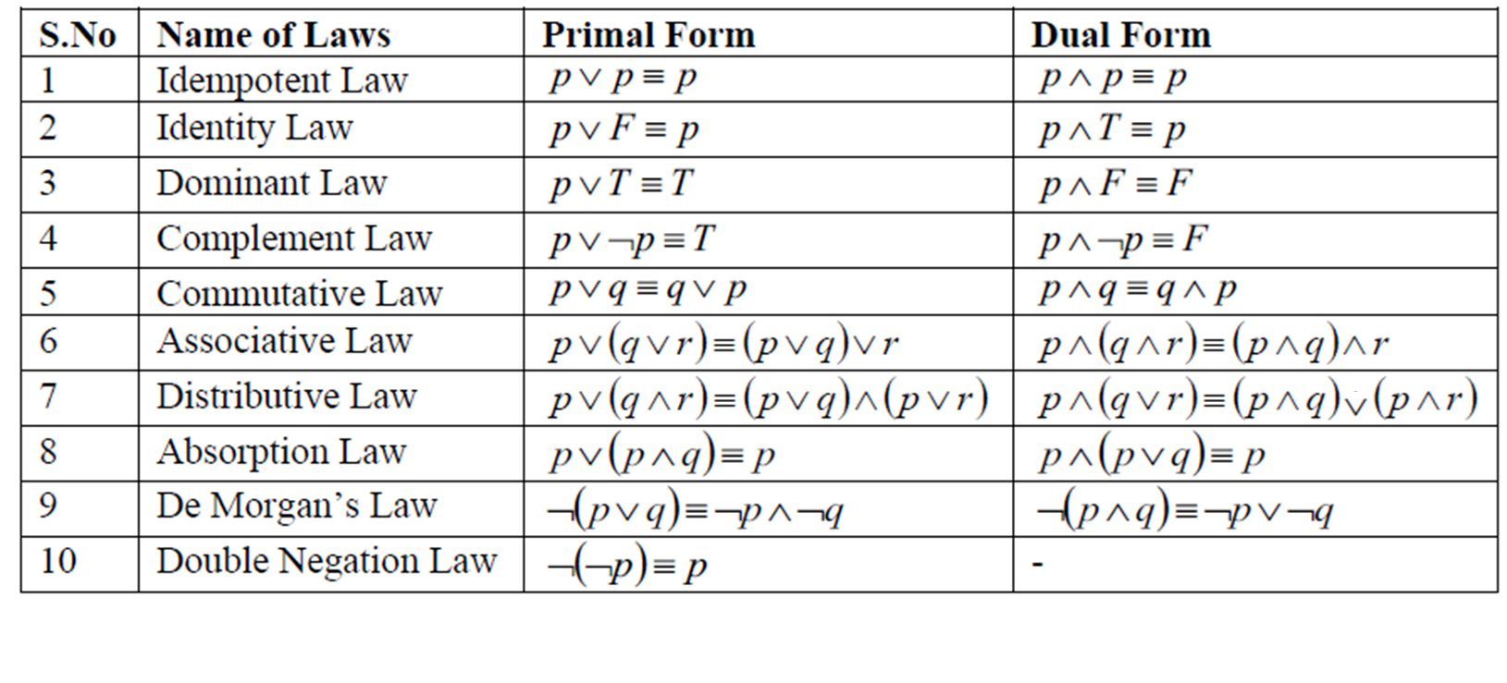
Laws of Propositional Logic:

Slide 20
Inverse, Converse, and Contra-positive
A conditional statement has two parts − Hypothesis and Conclusion
  If you do your homework, you will not be punished.
Inverse –An inverse of the conditional statement is the negation of both the hypothesis and the conclusion.
  If you do not do your homework, you will be punished
Converse−The converse of the conditional statement is computed by interchanging the hypothesis and the conclusion.
  If you will not be punished, you do not do your homework.
Contra-positive –The contra-positive of the conditional is computed by interchanging the hypothesis and the conclusion of the inverse statement.
  If you will be punished, you do your homework.

Slide 21
Show that [ ~P∩(~Q ∩R)V(Q ∩R)V(P ∩R)]≡R

Slide 22
Show that P↔Q≡(PVQ)=>(P ∩Q)

Slide 23
Prove that P→(Q →P) ≡ ~P →(P →Q)

Slide 24
Show that [(PVQ)~(~P∩(~QV~R))]V(~P ∩ ~Q)V(~PV~R)

Slide 25
Normal Forms
Elementary Product: If p and q are any two atomic variables, then
are some examples of elementary products.
Elementary Sum: If P and Q are any two atomic variables, then
are some examples of elementary sums.
A Normal Form is a standard or structured way of writing a logical expression using specific combinations of AND (∧), OR (∨), and NOT (¬).
  A propositional expression is in Disjunctive Normal Form if it is an OR (∨) of one or more AND (∧) terms.
    (A∧B)∨(C∧D) - AND terms connected by OR
  A propositional expression is in Conjunctive Normal Form if it is an AND (∧) of one or more OR (∨) terms.
    (A∨B)∧(C∨D) - OR terms connected by AND

Slide 26
Obtain Disjunctive Normal forms of (i) P∩(P→Q) (ii) ~(PVQ)↔(P∩Q)

Slide 27
Obtain Conjunctive Normal forms of
  (i)P∩(P→Q)
  (ii) ~(PVQ)↔(P ∩Q)

Slide 28
PREDICATES
Predicate Logic, also called First-Order Predicate Logic, extends propositional logic by allowing us to represent objects, their properties, relationships, and quantities.
While propositional logic deals with complete statements such as: "John is a student."
Predicate logic can represent a general statement such as: "Every student studies.“
  Propositional logic, P:Ravi is a student but not easily "All students are intelligent.“
A predicate is a statement containing one or more variables whose truth value depends on the value assigned to the variables.
  Eg: P(x):x>5 has P(x) as the predicate
A predicate becomes a proposition when a specific value is assigned to its variable.

Slide 29
Components of Predicate Logic
Variables : Variables represent unspecified objects.
  Eg: Student (x)
Constants : A constant represents a particular object or person.
  Eg: Student (Ravi)
Predicates: Predicates represent properties or relationships.
  Unary predicate: Student(x)
  Binary predicate: Likes(x,y)
  Ternary predicate: Between(x,y,z)
Logical connectives : ¬, ∧, ∨, →, ↔
Functions
Quantifiers

Slide 30
Functions
  Simple statement function : An expression with a predicate symbol and an individual variable
    Example: x is a man expressed as H(x); x is a Mortal expressed as M(x)
    Roy is a man expressed as H(Roy) (Substitution Instance)
  Compound Statement Function: Obtained by combining one or more simple statement functions and logical connectives.
    Example: x is a Man and x is Mortal expressed as H(x) ∧ M(x)
    X is taller than y expressed as G(x,y)
  Unary, binary & Ternary functions:
    Unary – Student(x)
    Binary – Likes(x,y)
    Ternary – Between(x,y,z)

Slide 31

QuantifierS
Quantifiers indicate how many elements of the domain satisfy a predicate.
  Universal quantifier - $∀$
    for all
    for every
    Eg: $∀x P\left(x\right)$ read as P(x) is true for every x in the domain.
    Every student has an ID
      $S\left(x\right)=x \text{is} \text{a} \text{student}$ , $I\left(x\right)=x \text{has} \text{an} \text{ID}$
      $∀x\left(S\left(x\right)→I\left(x\right)\right)$
  Existential quantifier - $∃$
    there exists
    for some
    Eg: $∃x P\left(x\right)$ read as There exists at least one x for which P(x) is true.
    Some student has scored more than 90.
      $∃$x(S(x)Λ Score(x)>90)
Every student passed
Some student passed

Slide 32

NESTED QUANTIFIERS
When more than one quantifier appears in a statement, we have nested quantifiers.
  $∀x∃y P\left(x,y\right)$ is read as For every x, there exists some y such that P(x,y) is true.
Order of Quantifiers Matters:
  Let: P(x,y)=x has sent an email to y
    $∀x∃y P\left(x,y\right)$ - Every person has sent an email to someone.
    $∃y∀x P\left(x,y\right)$ - There is one particular person to whom everyone has sent an email.

Slide 33



Example
All students are hardworking.
Some students are hardworking.
No student is absent.
Some student is not present.
Every student who studies and attends class passes.

Slide 34
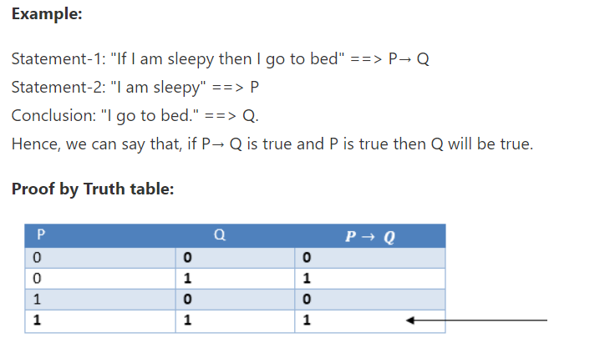

Slide 35
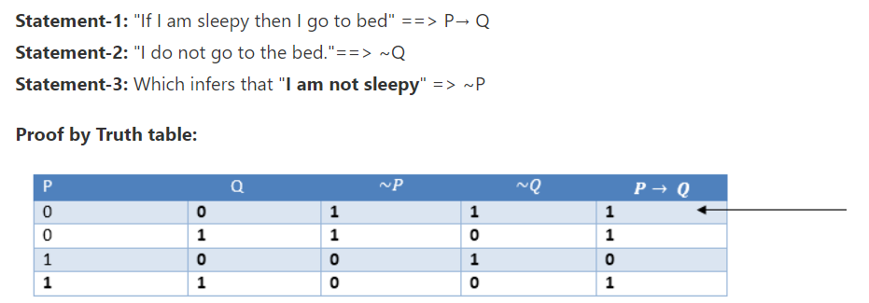
Modus Tollens:
The Modus Tollens rule state that if P→ Q is true and ¬ Q is true, then ¬ P will also true.

Slide 36
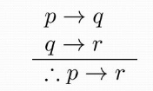
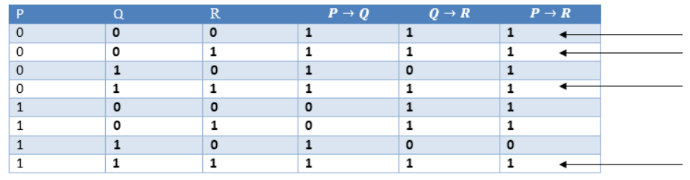
Hypothetical Syllogism:
The Hypothetical Syllogism rule state that if P→R is true whenever P→Q is true, and Q→R is true.
Example:
Statement-1: If you have my home key then you can unlock my home.
P→Q
Statement-2: If you can unlock my home then you can take my money.
Q→R
Conclusion: If you have my home key then you can take my money.
P→R

Slide 37
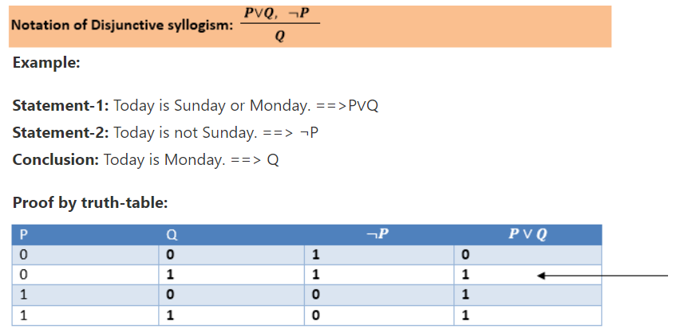
Disjunctive Syllogism:
The Disjunctive syllogism rule state that if P∨Q is true, and ¬P is true, then Q will be true.

Slide 38
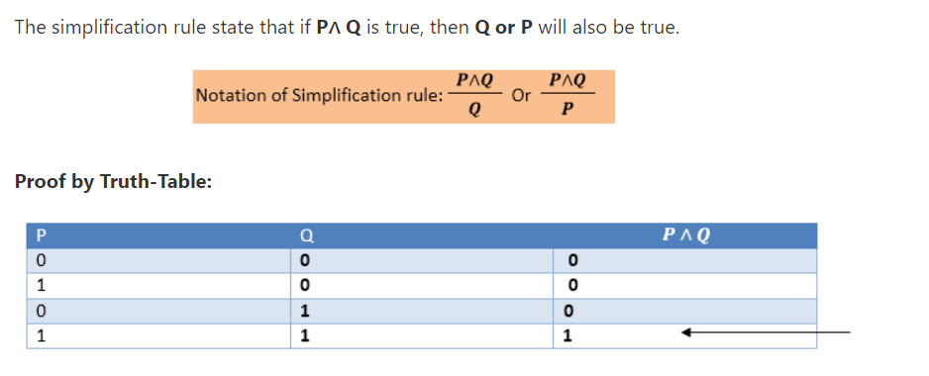
Simplification:

Slide 39
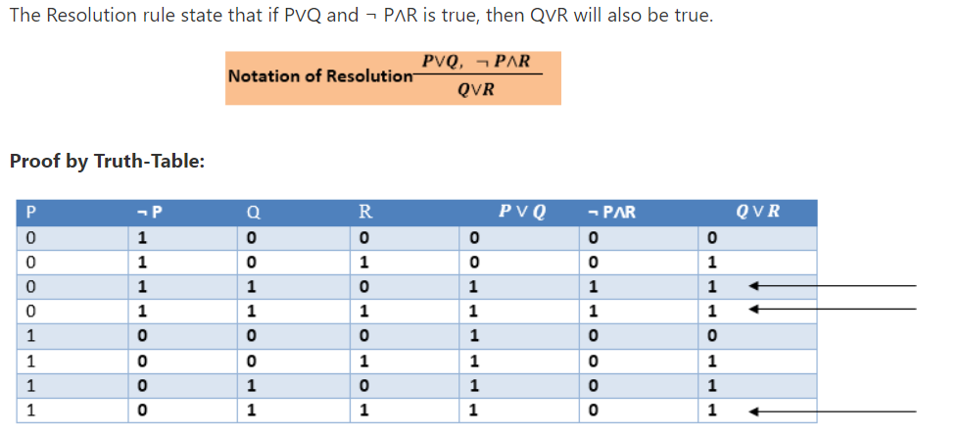
Resolution:

Slide 40
Resolution
Example1:
Premise 1: The student studies or attends a tutorial.
Premise 2: The student does not study or attends a tutorial.
Conclusion: Therefore, the student attends a tutorial.

Slide 41
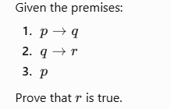
Resolution
Example 2:

Slide 42
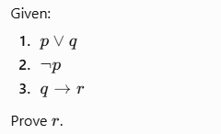
Resolution
Example 3

Slide 43
If A works hard, then either B or C will enjoy themselves. If B enjoys himself, then A will not work hard. If D enjoy himself, then C will not. Therefore, if A works hard, D will not enjoy himself. Show that these statements constitute a valid argument.

Slide 44
Thank you
QP Pattern
Answer Sheet
15 mins before exam
Hall ticket, ID card, Formal wear

